Slide 1
Common features AMA/Brazil

Slide 2
CCPA (or NA) to become ….
In all visuals, filters, folders, etc. where “CCPA” or “NA” is mentioned, we should rename this to “LA” for Brazil and “AMA” for AMA.
All changes that are shown with visuals in next slides are meant to be reapplied to ALL TABS (e.g. not only on “All controls”, but also on “Pending”)
NOTE: for tab “Summary Scorecard” the filter will need to include (in this order): Country, Data Subject Type, Function.

Slide 3
Notes:
Country filter to be added at the indicated position. This needs to be defaulted to “All” for AMA and to “Brazil” for Brazil.

Slide 4
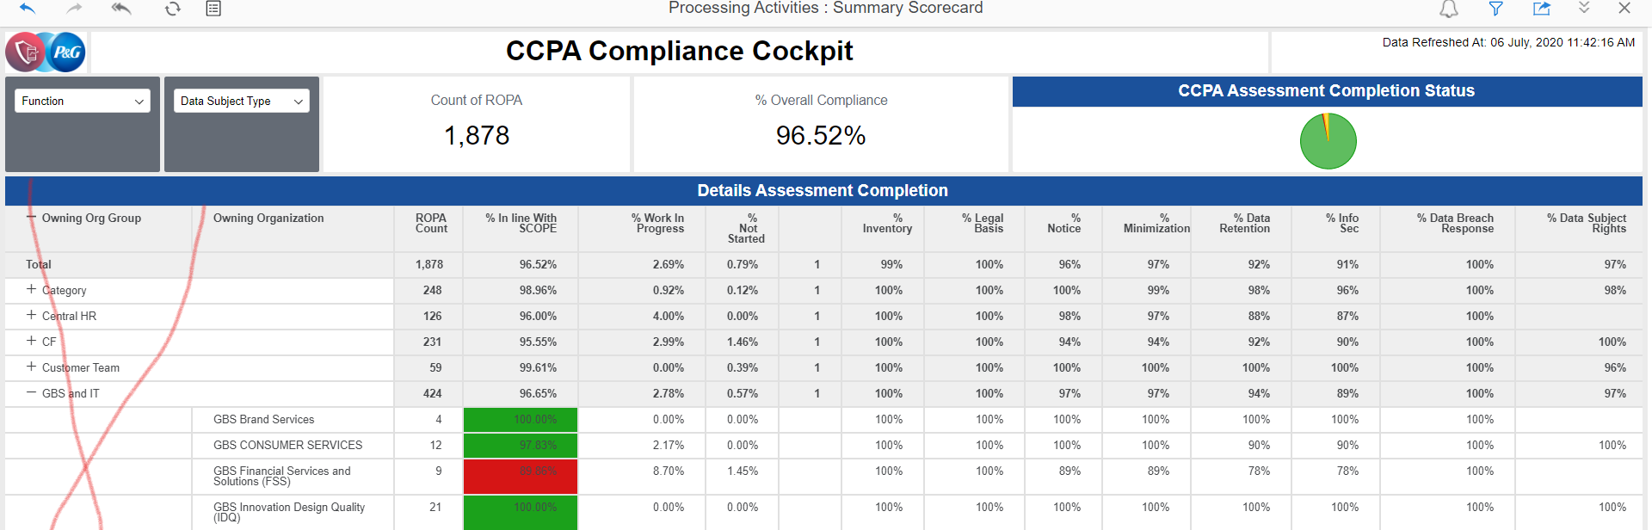
Remove column Owning Organization Group from tab “Summary Scorecard”

Slide 5
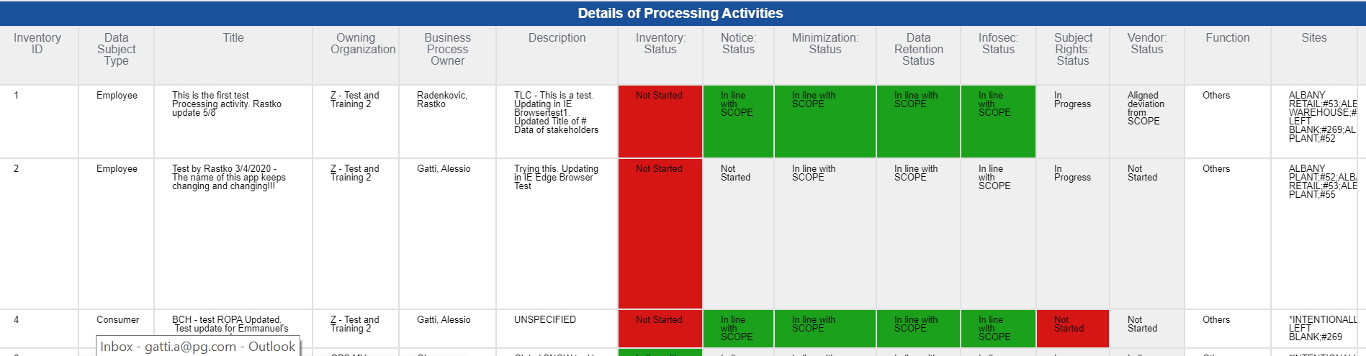
Details of Processing Activity Visual
Inventory ID
Data Subject Type
PA Name
Owning Organization
PA Owner
Additional information
All compliance controls (mind difference between AMA and Brazil)
Function
Sites
SCOPE number
Repository Type
Vendor involved
SAP Vendor Number
SAP Vendor name
Vendor Qualification
Country Collected
RoPA linked to IT Asset
Unregistered Application Info
Life Cycle Status
# Pending Compliance Controls
# Completed Compliance Controls
Notes:
Please be aware that the number and sequence of fields of AMA input file is different from CCPA and from Brazil, yet the list of fields to be displayed in the details screen is currently the same.

Slide 6
AMA

Slide 7
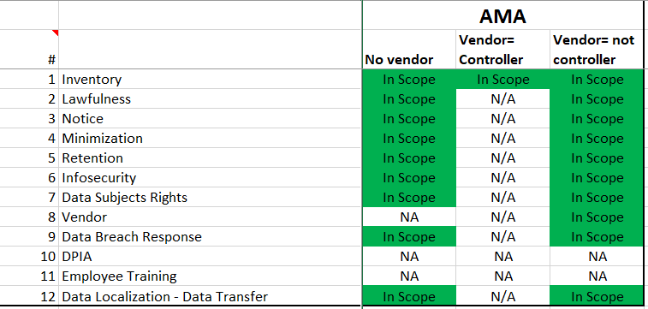
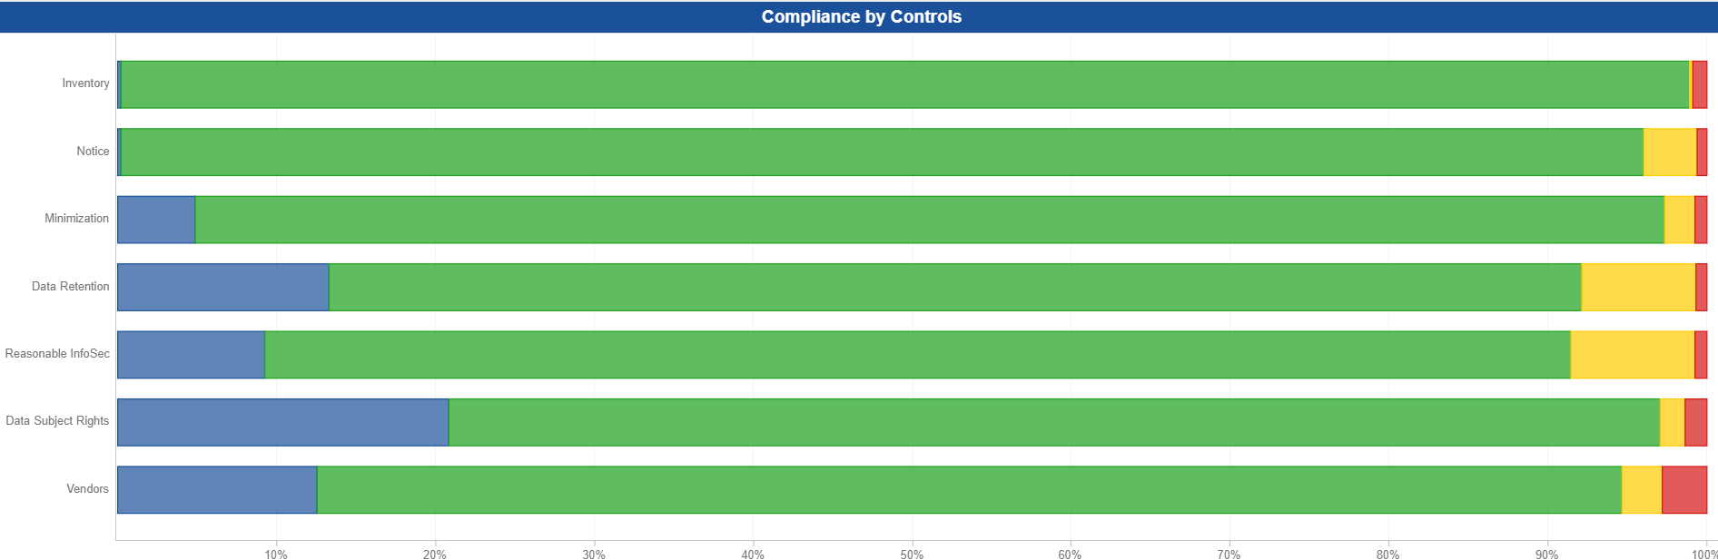

Compliance Controls
Notes:
Please check AMA Compliance controls and ensure that the visual in main cockpit, the calculation and the calculation logic tab show consistently. Also the details visual needs to show different compliance controls and assign color coding according to different rules. Same principle applies: an out of scope compliance control will have no background color and will not be counted in overall compliance, an in scope compliance control will be red if blank, Not started or WIP and green when In line with SCOPE or Aligned deviation from SCOPE.

Slide 8
Brazil

Slide 9
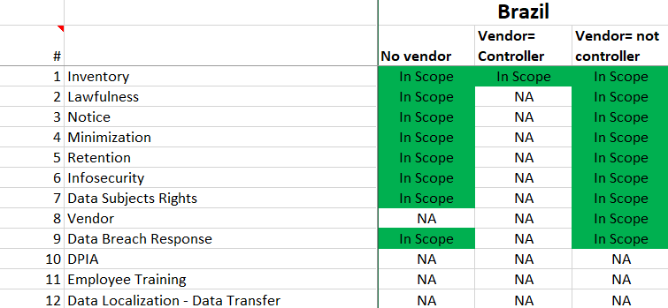
Compliance Controls
Notes:
Please check Brazil Compliance controls and ensure that the visual in main cockpit, the calculation and the calculation logic tab show consistently. Also the details visual needs to show different compliance controls and assign color coding according to different rules. Same principle applies: an out of scope compliance control will have no background color and will not be counted in overall compliance, an in scope compliance control will be red if blank, Not started or WIP and green when In line with SCOPE or Aligned deviation from SCOPE.

Slide 10
Backup Material

Slide 11
